Slide 1

Original Article Donanemab in Early Alzheimer’s Disease
Mark A. Mintun, M.D., Albert C. Lo, M.D., Ph.D., Cynthia Duggan Evans, Ph.D., Alette M. Wessels, Ph.D., Paul A. Ardayfio, Ph.D., Scott W. Andersen, M.S., Sergey Shcherbinin, Ph.D., JonDavid Sparks, Ph.D., John R. Sims, M.D., Miroslaw Brys, M.D., Ph.D., Liana G. Apostolova, M.D., Stephen P. Salloway, M.D., and Daniel M. Skovronsky, M.D., Ph.D.
N Engl J Med
Volume 384(18):1691-1704
May 6, 2021

Slide 2
Study Overview
A phase 2 trial of donanemab, an antibody that targets amyloid deposited in the brain, showed a better composite score for cognition and for the ability to perform activities of daily living than placebo at 76 weeks in patients with early Alzheimer’s disease.
Results for secondary outcomes were generally similar in the two trial groups.

Slide 3
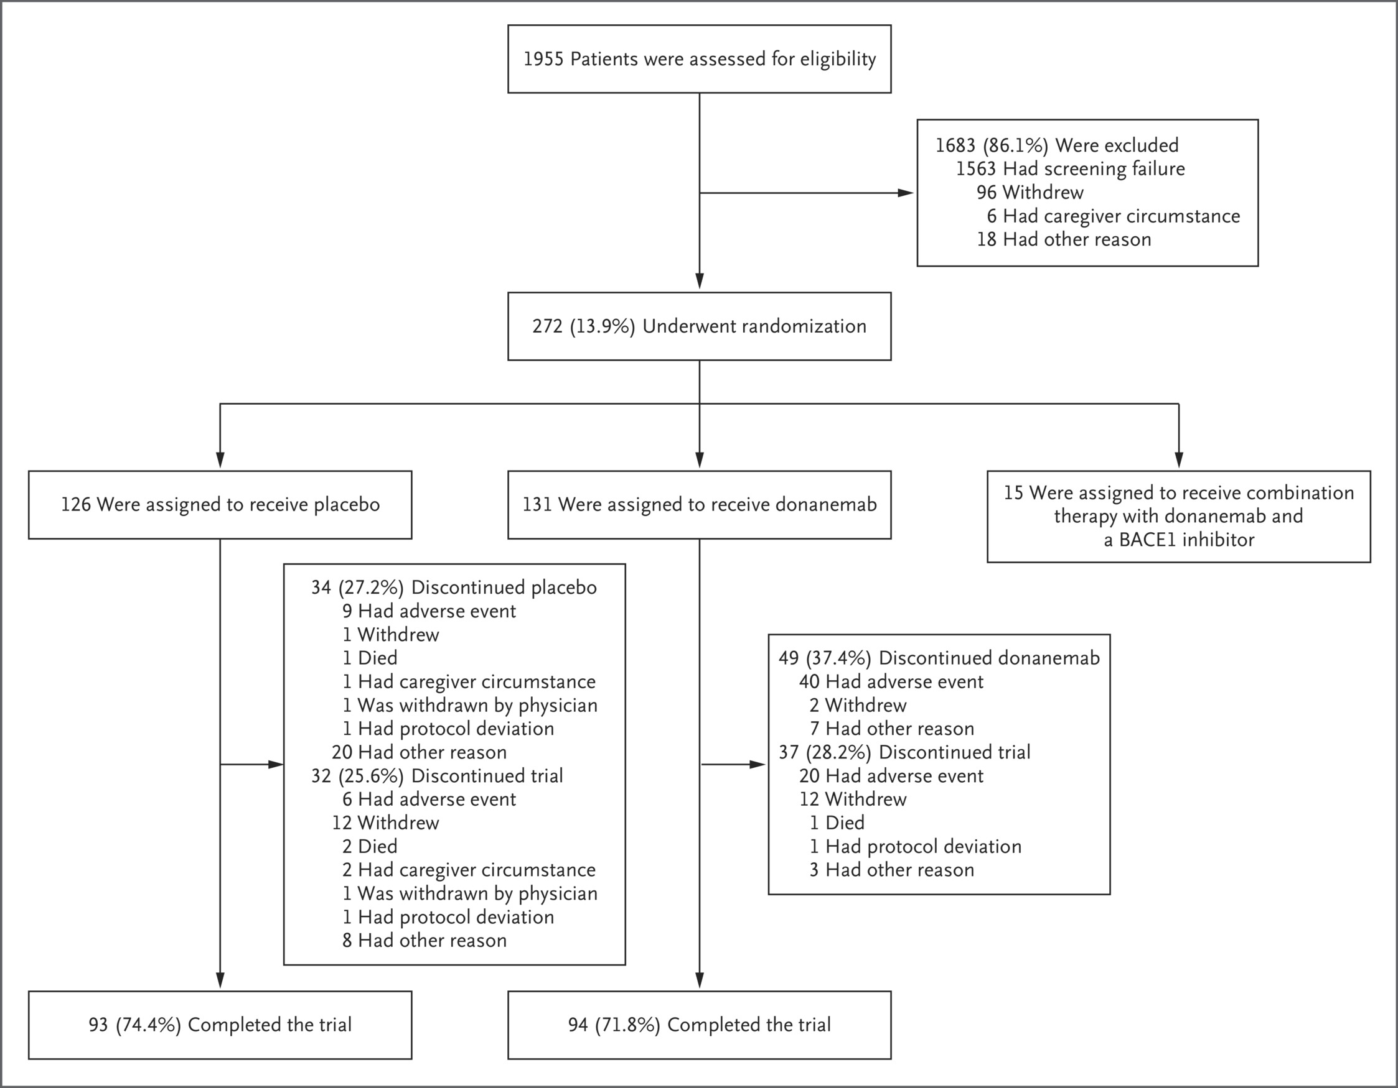
Enrollment, Randomization, and Trial Completion.
Mintun MA et al. N Engl J Med2021;384:1691-1704
Notes:
Figure 1 Enrollment, Randomization, and Trial Completion. One participant was randomly assigned to the placebo group but discontinued the trial before receiving an infusion and was not included in the modified intention-to-treat population. The combination-therapy group was discontinued; details are provided in the protocol. Information regarding specific reasons for screening failure is provided in Table S1 in the Supplementary Appendix.

Slide 4
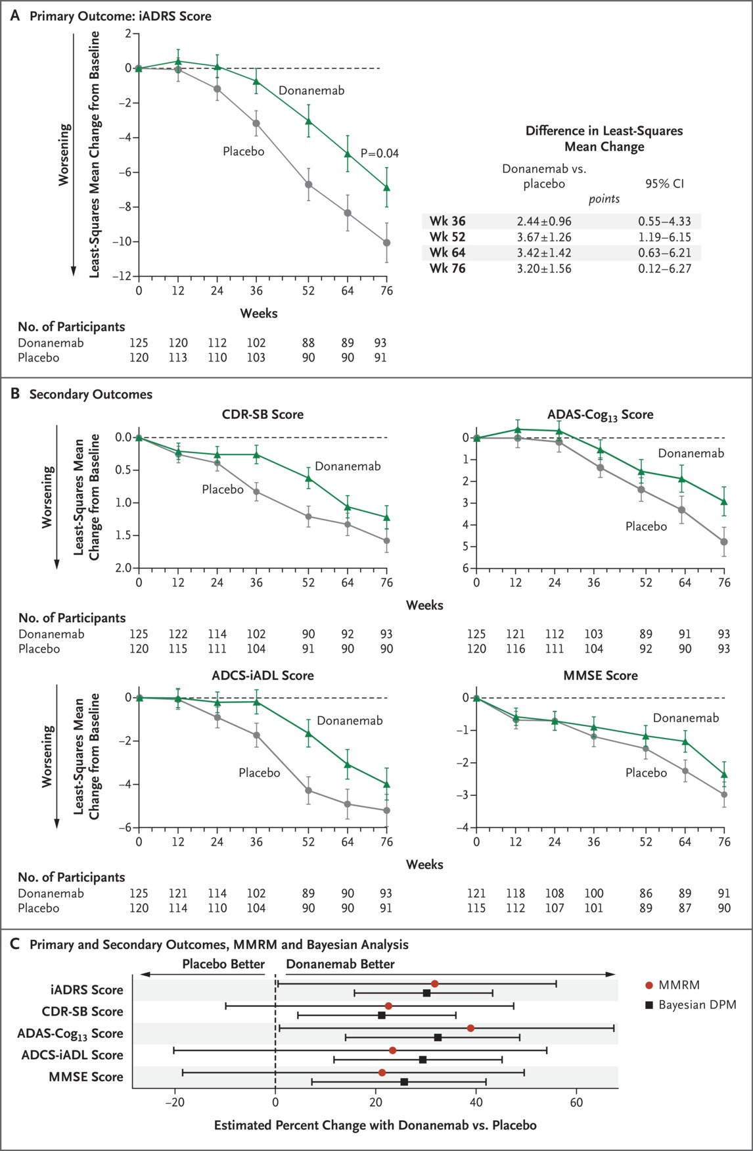
Primary and Secondary Clinical Outcomes.
Mintun MA et al. N Engl J Med2021;384:1691-1704
Notes:
Figure 2 Primary and Secondary Clinical Outcomes. Panel A shows the results for the primary outcome, the least-squares mean change from baseline to 76 weeks in the score on the Integrated Alzheimer’s Disease Rating Scale (iADRS; scores range from 0 to 144, with lower scores indicating a greater cognitive deficit and greater impairment of the ability to perform activities of daily living), in the donanemab group and the placebo group, analyzed with a mixed model for repeated measures (MMRM). The difference between the donanemab group and the placebo group in the primary outcome was 3.20 (95% confidence interval [CI], 0.12 to 6.27; P=0.04). Panel B shows the results for secondary clinical outcomes, including the least-squares mean change from baseline to 76 weeks in scores on the Clinical Dementia Rating Scale–Sum of Boxes (CDR-SB; scores range from 0 to 18, with higher scores indicating greater impairment), the 13-item cognitive subscale of the Alzheimer’s Disease Assessment Scale (ADAS-Cog₁₃; scores range from 0 to 85, with higher scores indicating a greater deficit), the Alzheimer’s Disease Cooperative Study–Instrumental Activities of Daily Living Inventory (ADCS-iADL; scores range from 0 to 59, with lower scores indicating greater impairment), and the Mini–Mental State Examination (MMSE; scores range from 0 to 30, with higher scores indicating better mental performance), in the donanemab group and the placebo group, analyzed with the MMRM. Panel C shows the estimated percent change in the iADRS, CDR-SB, ADAS-Cog₁₃, ADCS-iADL, and MMSE scores in the donanemab group as compared with the placebo group, analyzed with the MMRM at 76 weeks (with 95% confidence intervals) and with the Bayesian disease progression model (DPM) over the entire 18-month intervention period (with 95% credible intervals). The credible intervals for data in the Bayesian disease progression model were not adjusted for multiple comparisons, and no definite conclusions can be drawn. Plus–minus values are means ±SE. 𝙸 bars indicate standard errors.

Slide 5
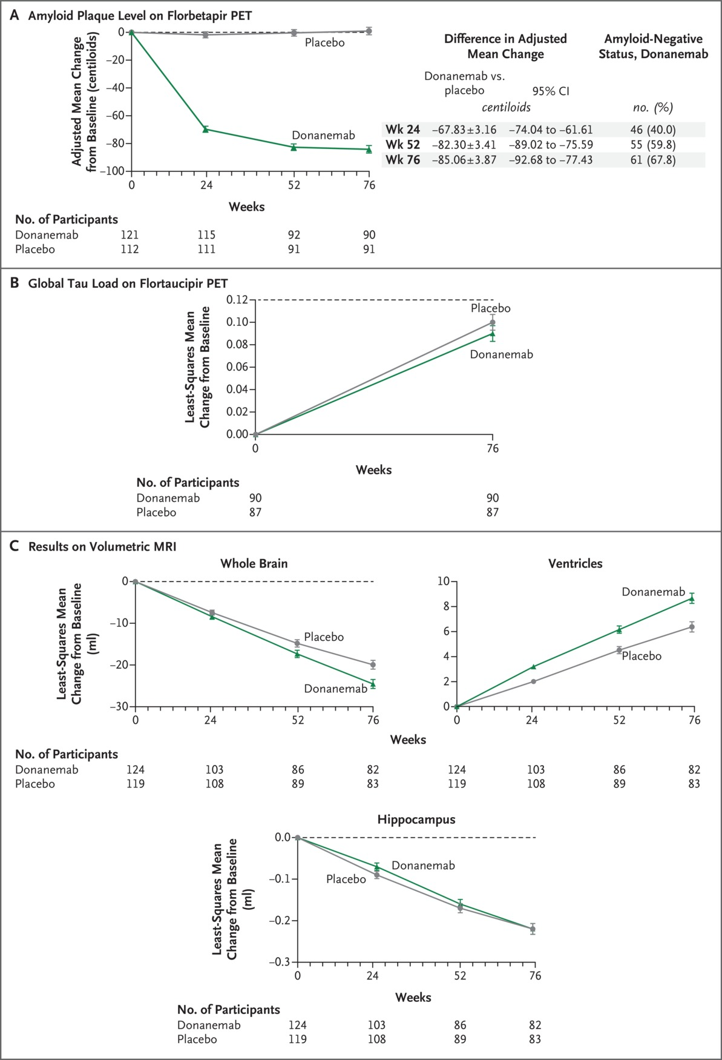
Secondary Biomarker Outcomes.
Mintun MA et al. N Engl J Med2021;384:1691-1704
Notes:
Figure 3 Secondary Biomarker Outcomes. Results are shown for secondary biomarker outcomes, including the change from baseline to 76 weeks in the level of amyloid plaques deposited in the brain as assessed by positron-emission tomography (PET) with injection of ¹⁸F-florbetapir (Panel A), in the global tau load as assessed by PET with injection of ¹⁸F-flortaucipir (Panel B), and in the whole-brain volume, ventricular volume, and hippocampal volume as assessed by volumetric magnetic resonance imaging (MRI) (Panel C). Amyloid-negative status is defined as an amyloid plaque level of less than 24.10 centiloids, which is the average level among otherwise healthy persons of a similar age. Plus–minus values are means ±SE. 𝙸 bars indicate standard errors.

Slide 6
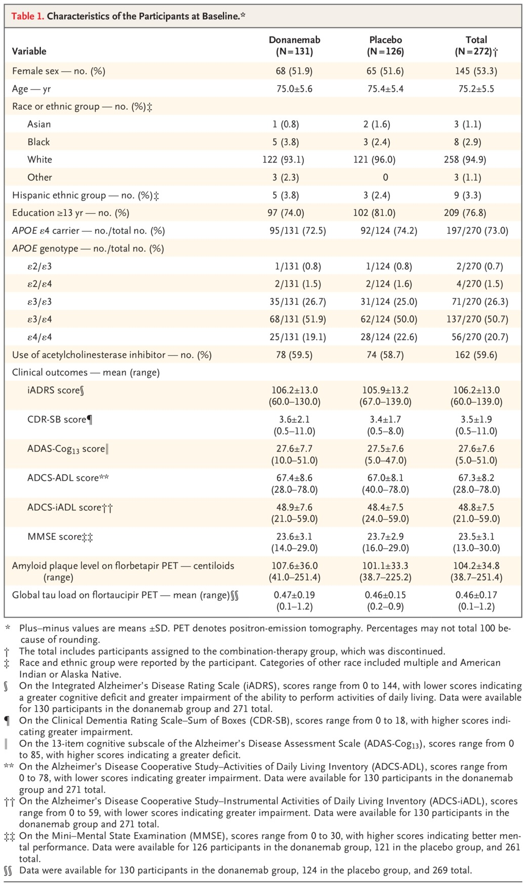
Characteristics of the Participants at Baseline.
Mintun MA et al. N Engl J Med2021;384:1691-1704
Notes:
Table 1 Characteristics of the Participants at Baseline.

Slide 7
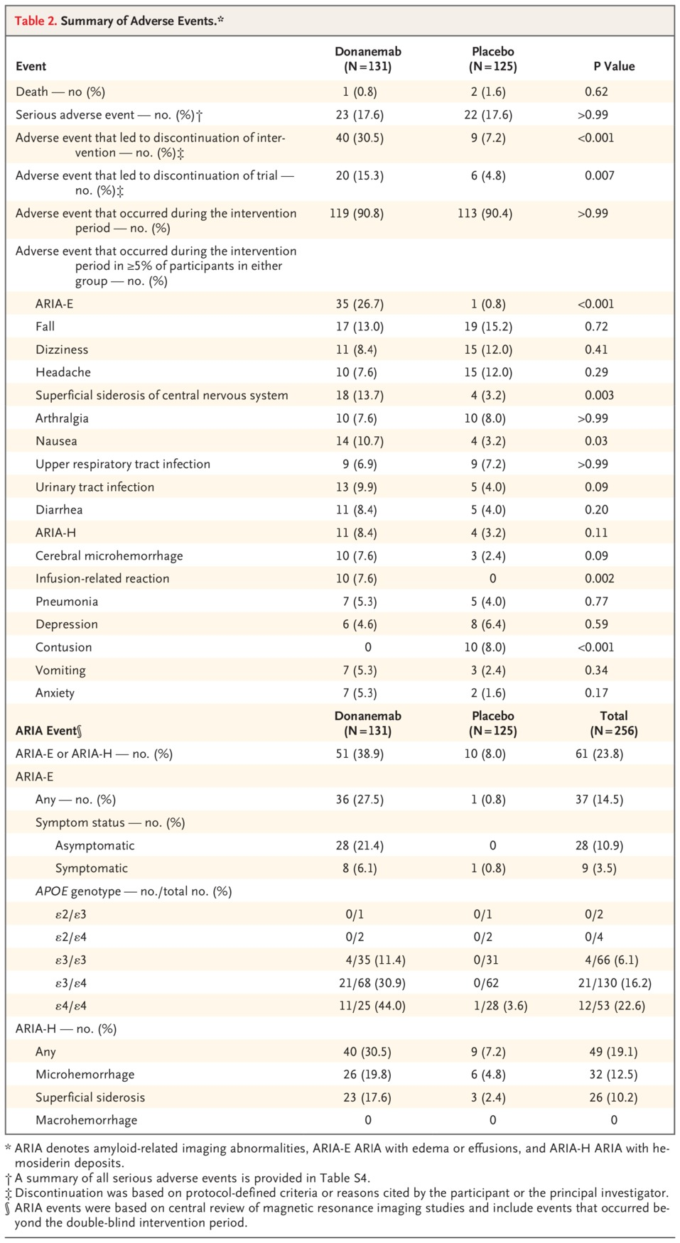
Summary of Adverse Events.
Mintun MA et al. N Engl J Med2021;384:1691-1704
Notes:
Table 2 Summary of Adverse Events.

Slide 8
Conclusions
In patients with early Alzheimer’s disease, donanemab resulted in a better composite score for cognition and for the ability to perform activities of daily living than placebo at 76 weeks, although results for secondary outcomes were mixed.
Longer and larger trials are necessary to study the efficacy and safety of donanemab in Alzheimer’s disease.

